Slide 1
Module 8: Getting Started with Computer Vision

Slide 2
Module Agenda
Analyzing Images
Analyzing Videos

Slide 3
Lesson 1: Analyzing Images

Slide 4


The Computer Vision Service
Image analysis:
Description and tag generation
Object detection
Face detection
Image metadata, color, and type analysis
Categorization - including, celebrity and landmark identification
Brand detection
Moderation ratings
Optical character recognition
Smart thumbnail generation
Can be used as:
Standalone Computer Vision resource
Multi-service Cognitive Services resource
Objects:
Mountain
Text: "Wish you were here!"
Caption: "A mountain with snow"
Tags:
outdoor
mountain
snow
Thumbnail:
Metadata:
Width:800
Height:600
Format: Jpeg
Wish you were here!

Slide 5
Image Analysis
86 built-in categories.
Celebrities and landmarks in details sub-list (if requested)
{
"categories": [
{
"name": "_outdoor_mountain",
"confidence": "0.9"}
],
"adult": {"isAdultContent": "false", …},
"tags": [
{"name": "outdoor", "confidence": 0.9},
{"name": "mountain", " confidence ": 0.9}],
"description": {
"tags":["outdoor", "mountain"],
"captions": [
{"name": "A mountain with snow",
"confidence": 0.9}]},
"metadata":
{"width":60,"height":30, format:"Jpeg"},
"faces": […],
"brands": […],
"color": {"dominantColorForeground": "Brown",…},
"imageType": {"clipArtType": 0, …},
"objects" : [
{
"rectangle": {x:20, y:25, w:10, h:20},
"object": "mountain",
"confidence": 0.9}]
}
Single Analyze Image function to retrieve full analysis
Individual functions for specific analyses:
Describe Image, Tag Image, Detect Objects, …
Ratings for "adult", "racy", and "gore"
if Tags specified
https://{endpoint}/vision/v3.1/analyze[?visualFeatures][&details][&language]
Features to return:
Description
Tags
Brands
Categories
Color
Objects
Faces
ImageType
Adult
Description also includes tags
Domain-specific details:
Celebrities
Landmarks
Image metadata
Results language:
en (default)
es
ja
pt
zh
If faces detected
If brands detected
Body:
{"url": "http://path-to-image}
or
[ binary-image-data]
clipart? line-drawing?
color palette
Object name and bounding box

Slide 6
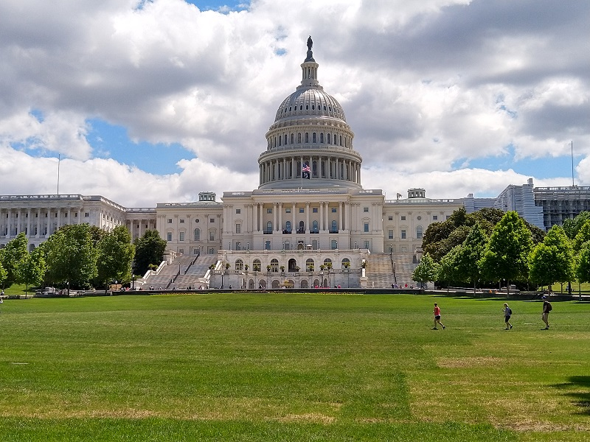
Smart-Cropped Thumbnails
Generate a small, cropped version of an image
Smart cropping identifies the region of interest (ROI)
https://{endpoint}/vision/v3.1/thumbnail[?width][&height][&smartCropping]
Desired width
Desired height
Use smart cropping?
Body:
{"url": "http://path-to-image}
or
[ binary-image-data]

Slide 7
Lab – Analyze Images with Computer Vision
Analyze images
Create a thumbnail

Slide 8
Lesson 2: Analyzing Videos

Slide 9
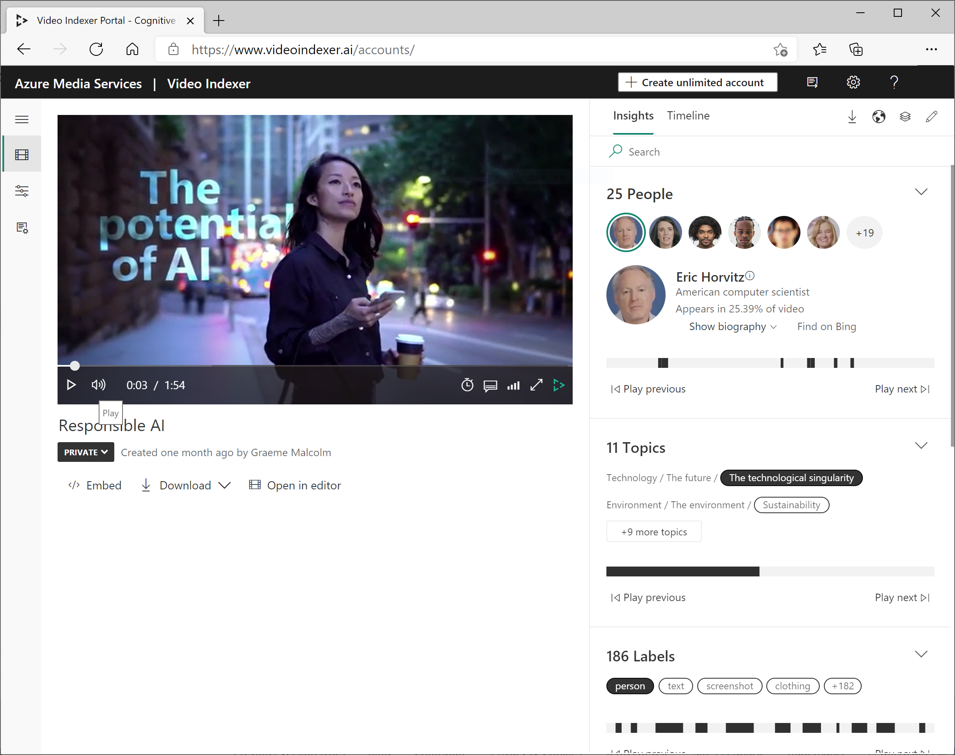
Video Analyzer for Media
Video analysis:
Facial recognition
Optical character recognition
Speech transcription
Topics
Sentiment
Labels
Content moderation
Scene segmentation
Service options:
Standalone free version (limitations apply)
Connected to Azure Media Services

Slide 10





Custom Insights
Pre-defined models for recognizing language, well-known celebrities, brands, …
Create your own models for:
People
Language
Brands
Animated Characters
Train facial recognition from sample images
Recognize industry / organization-specific terms
Recognize brand names for products, companies, projects,..
Identify individual characters in animations

Slide 11
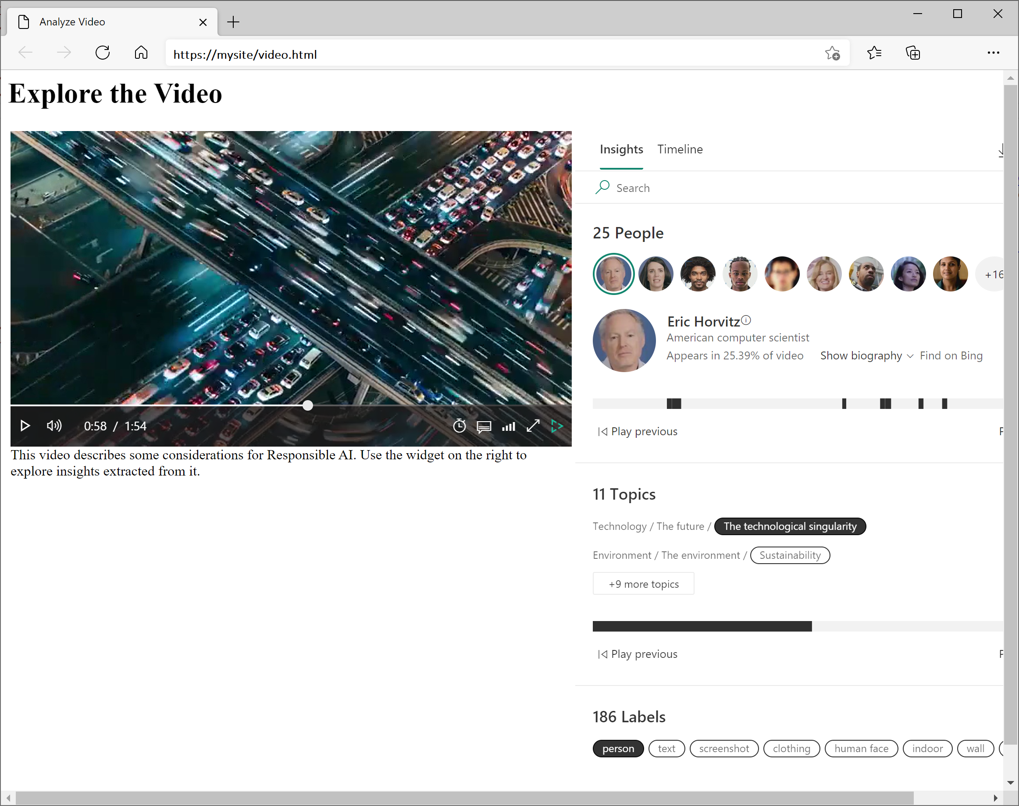
Video Analyzer Widgets and API
Share insights and analysis in web pages
Automate video analysis with the REST API
https://api.videoindexer.ai.../Videos?accessToken=$token
{
"results": [
{
"accountId": "1234abcd-9876fghi-0156kihb-00123",
"id": "a12345bc6",
"name": "Responsible AI",
"description": "Microsoft Responsible AI video",
"created": "2021-01-05T15:33:58.918+00:00",
"lastModified": "2021-01-05T15:50:03.123+00:00",
"lastIndexed": "2021-01-05T15:34:08.007+00:00",
"processingProgress": "100%",
"durationInSeconds": 114,
"sourceLanguage": "en-US",
}
],
}

Slide 12
Lab – Analyze Video
Analyze a video
Use Video Analyzer widgets
Use the Video Analyzer API

Slide 13

Module Review
You want to use the Computer Vision Analyze Image function to generate an appropriate caption for an image. Which visual feature should you specify?
Tags
Description
Categories
What is the effect of the smartCropping option when using Computer Vision to generate a thumbnail?
The aspect ratio of the original image is maintained.
The thumbnail is skewed to fit the specified proportions.
The region of interest is centered in the thumbnail.
You want Video Analyzer to recognize colleagues in videos recorded from conference calls.
What should you do?
Create a custom model containing a Person for each colleague, with example images of their faces.
Edit the conference call videos to include a caption of each person's name on their first appearance.
Embed the Video Analyzer widgets in a custom web site that employees access using their own user credentials.
Notes:
Use the slide animation to reveal the correct answers.

Slide 14
Closing slide

